Slide 1

Time Series
Koh June wen | 2112956 | daaaft2a04

Slide 2
Contents
1)
2)
Exploratory Data Analysis
Modelling and Evaluation

Slide 3

Exploratory Data Analysis

Slide 4
Stationarity of Data
P-values
CO - 2.687004e-16
HC - 1.296923e-16
NO2 - 1.378924e-17
O3 - 2.314190e-16
With p-values so low for all of the Gas types, we can say that all of the time series are stationary

Slide 5
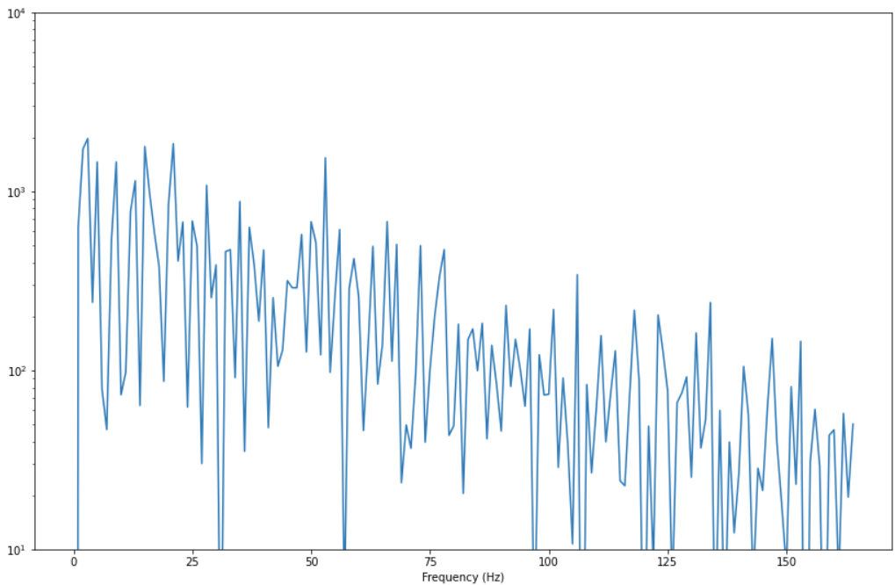
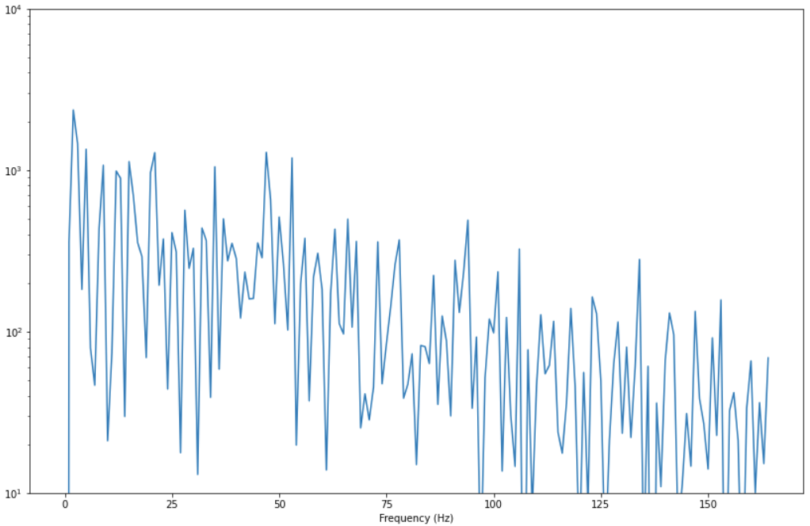
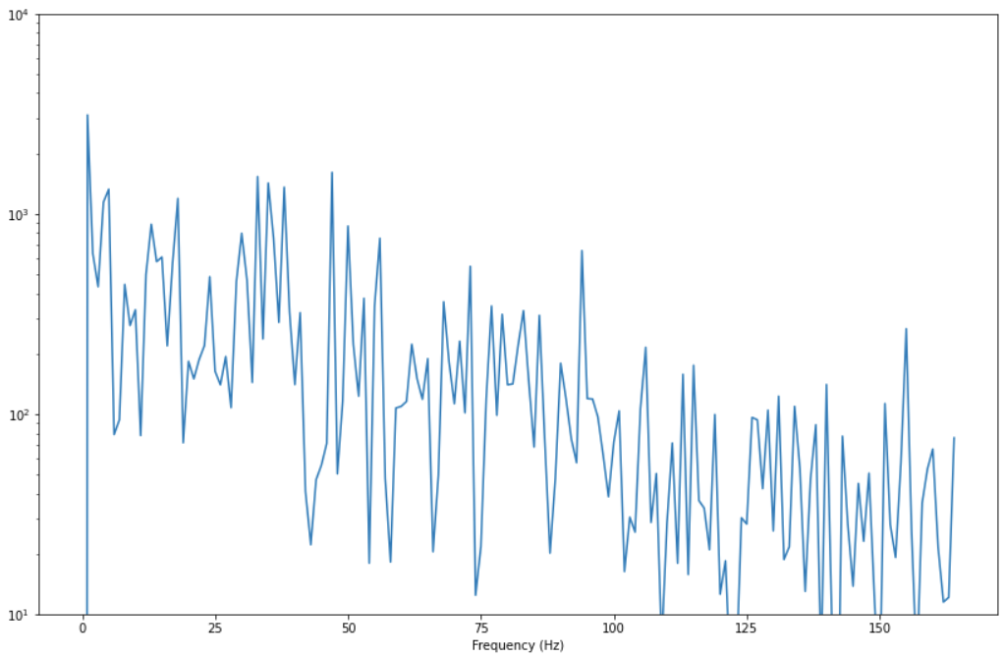
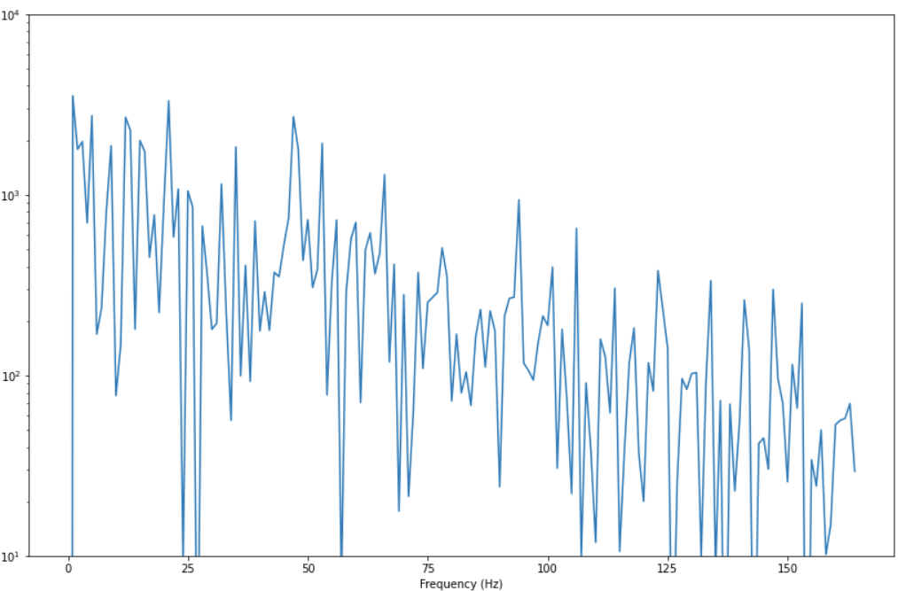
Seasonality of Data
These periodograms show that there is no seasonality for the Gases (CO, HC, NO2, O3).
If there was a seasonality, the periodograms will show an evident spike while the surrounding y values will be relatively flat.

Slide 6
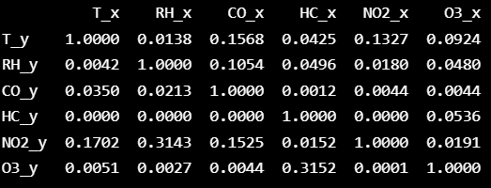
Causality Test
Null hypothesis: Variables are not causal to each other
Each column represents a predictor x of each variable and each row represents the response y and the p-value of each pair of variables are shown in the matrix
For instance, value 0.0012 (in row 3, column 4), it refers that HC_x is causal to CO_y and hence, we can reject the null hypothesis.
70% of the comparisons reject the null hypothesis. This suggests that the variables are interchangeably causing each other. This makes this data a decent candidate for using Vector Models to forecast

Slide 7
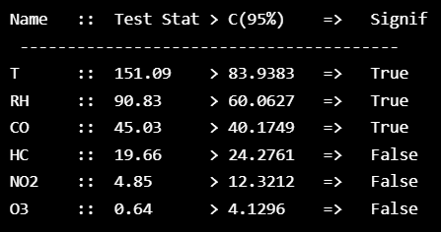
Cointegration Test
This shows that T, RH, CO have a statistically significant connection between two or more series.
When two or more time series are cointegrated, it means that they have a long run, statistically significant relationship.

Slide 8

Modelling and Evaluation

Slide 9
Models Tested
AutoRegressive Integrated MovingAverage Model (ARIMA)
Vector AutoRegressive Model (VAR)

Slide 10
Model Tuning
Evaluation Metrics:
AIC:
Used over AIC because this is better for modelling a predictive model while BIC is better for modelling an explanatory model
RMSE:
The RMSE from cross validation

Slide 11
Model Tuning
A
B
C
D
Cross Validation:
Data is split into 4 parts
CV1: Part A will be trained then tested against B
CV2: Part A+B will be trained then tested against C
CV3: Part A+B+C will be trained then tested against D
The average RMSE, AIC will be compared.

Slide 12
VAR Model
AIC
The best lowest AIC value is given when the Lag is 8
With Cross Validation the Lag is still 8
RMSE
The lowest RMSE value is given when the Lag is 1 with cross validation

Slide 13
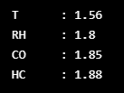
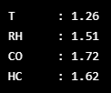
VAR Model
Serial Correlation Residuals
AIC
RMSE
The values for AIC is closer to 2 than RMSE which means that the model produced with 8 lags explains the variances and patterns better than 1 lags.

Slide 14
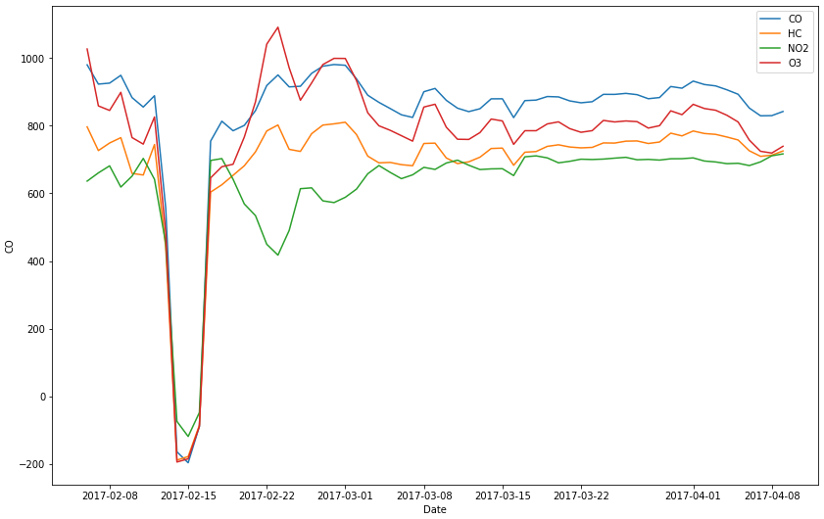
VAR Model
With Lags of 8 the Kaggle public leader board showed a result of 174.00740 RMSE

Slide 15
ARIMA Model
Started off with Gridsearch for the entire training dataset, using AIC as the comparison metric
CO_order = (1,1,2)
HC_order = (2,1,1)
NO2_order = (2,1,1)
O3_order = (2,1,1)
Kaggle RMSE = 154.24407

Slide 16
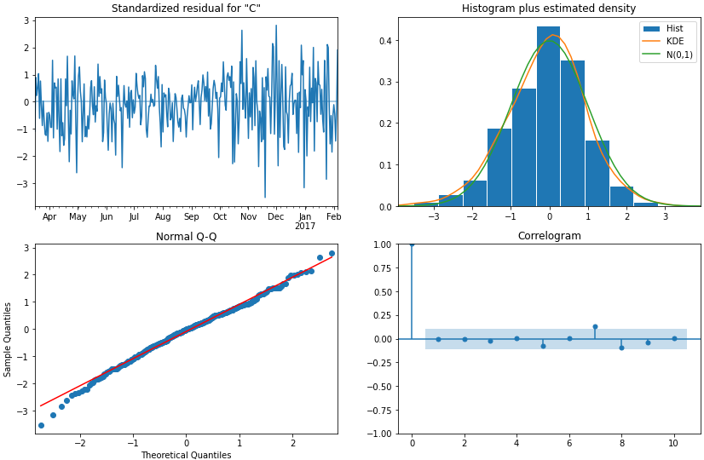
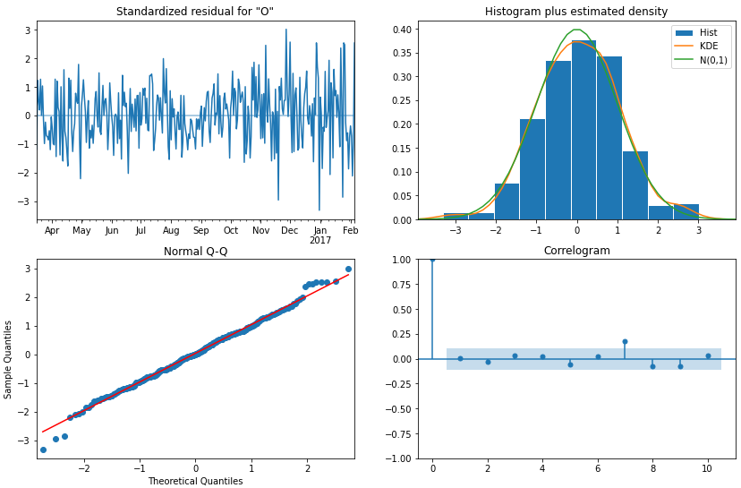
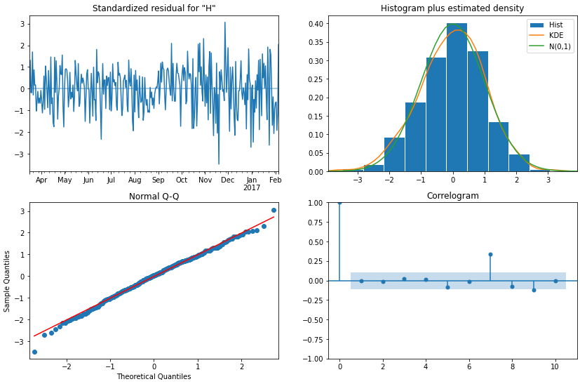
ARIMA Model
The diagnostic plots for CO, HC, O3 show that the residuals of the models have little correlation and conform to the normal distribution.

Slide 17
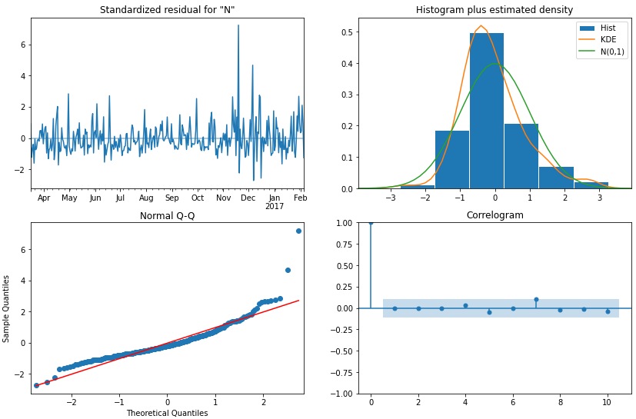
ARIMA Model
However, the diagnostic plot for NO2 have some correlation and the residuals do not conform to the normal distribution.

Slide 18
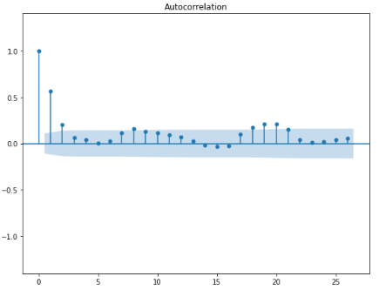
ARIMA Model
Model Improvement
Knowing that there is some pattern remaining in the residuals for NO2. I believed that it could be seasonality that is present for NO2.
The ACF plot shows that there is a clear seasonality for NO2
The period of the seasonality is shown to be 8
8

Slide 19
ARIMA Model
Model Improvement
Performed Gridesearch on the entire dataset, using AIC as the comparison metric
CO_order = (1,1,2)
HC_order = (2,1,1)
NO2_order = (2,1,1)
NO2_seasonal_order = (1,2,2,8)
O3_order = (1,1,2)
Kaggle RMSE = 153.33767 (My best score)

Slide 20
ARIMA Model
Model Improvement
As my first few tests were only on the training data with no testing data and only using the AIC metric I knew that there was more testing I could do.

Slide 21
ARIMA Model
Model Improvement
Scoring Metrics | NO2 seasonal order | Cross Validation | Kaggle RMSE
AIC | Yes | Yes | 176.88901
RMSE | Yes | Yes | 153.53418
RMSE | Yes | No | 183.41228
From my additional hyperparameter tuning and testing, I did not yield any better results

Slide 22

Conclusion

Slide 23
Conclusion
The best model for the forecasting is 4 ARIMA models each one for each gas. With the following order hyperparameters
CO – (1,1,2)
HC – (2,1,1)
NO2 – (2,1,1) | (1,2,2,8)
O3 – (1,1,2)

